Slide 1
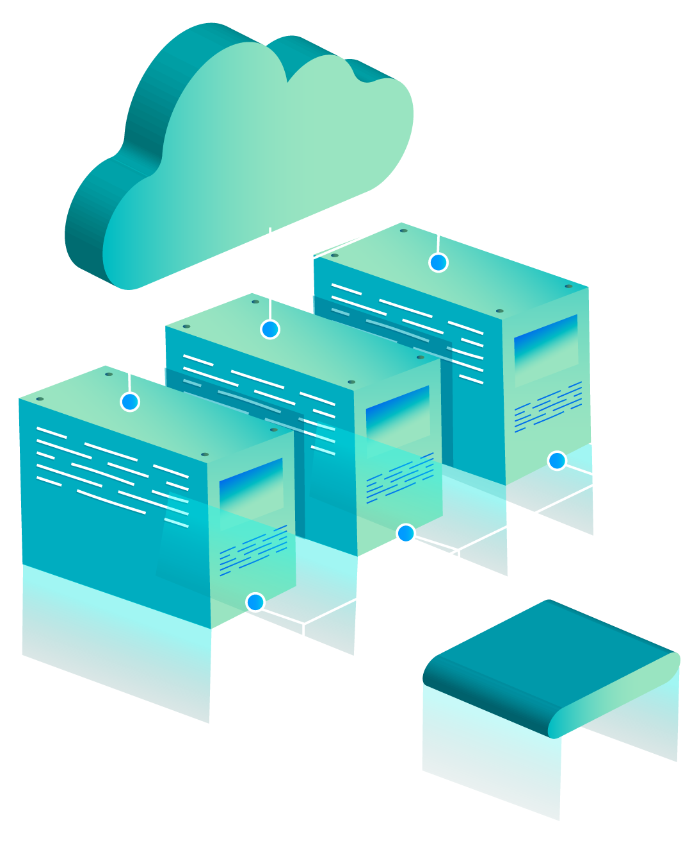
INTRO TO
AWS
MDIBL Comparative Genomics and Data Science Core

Slide 2
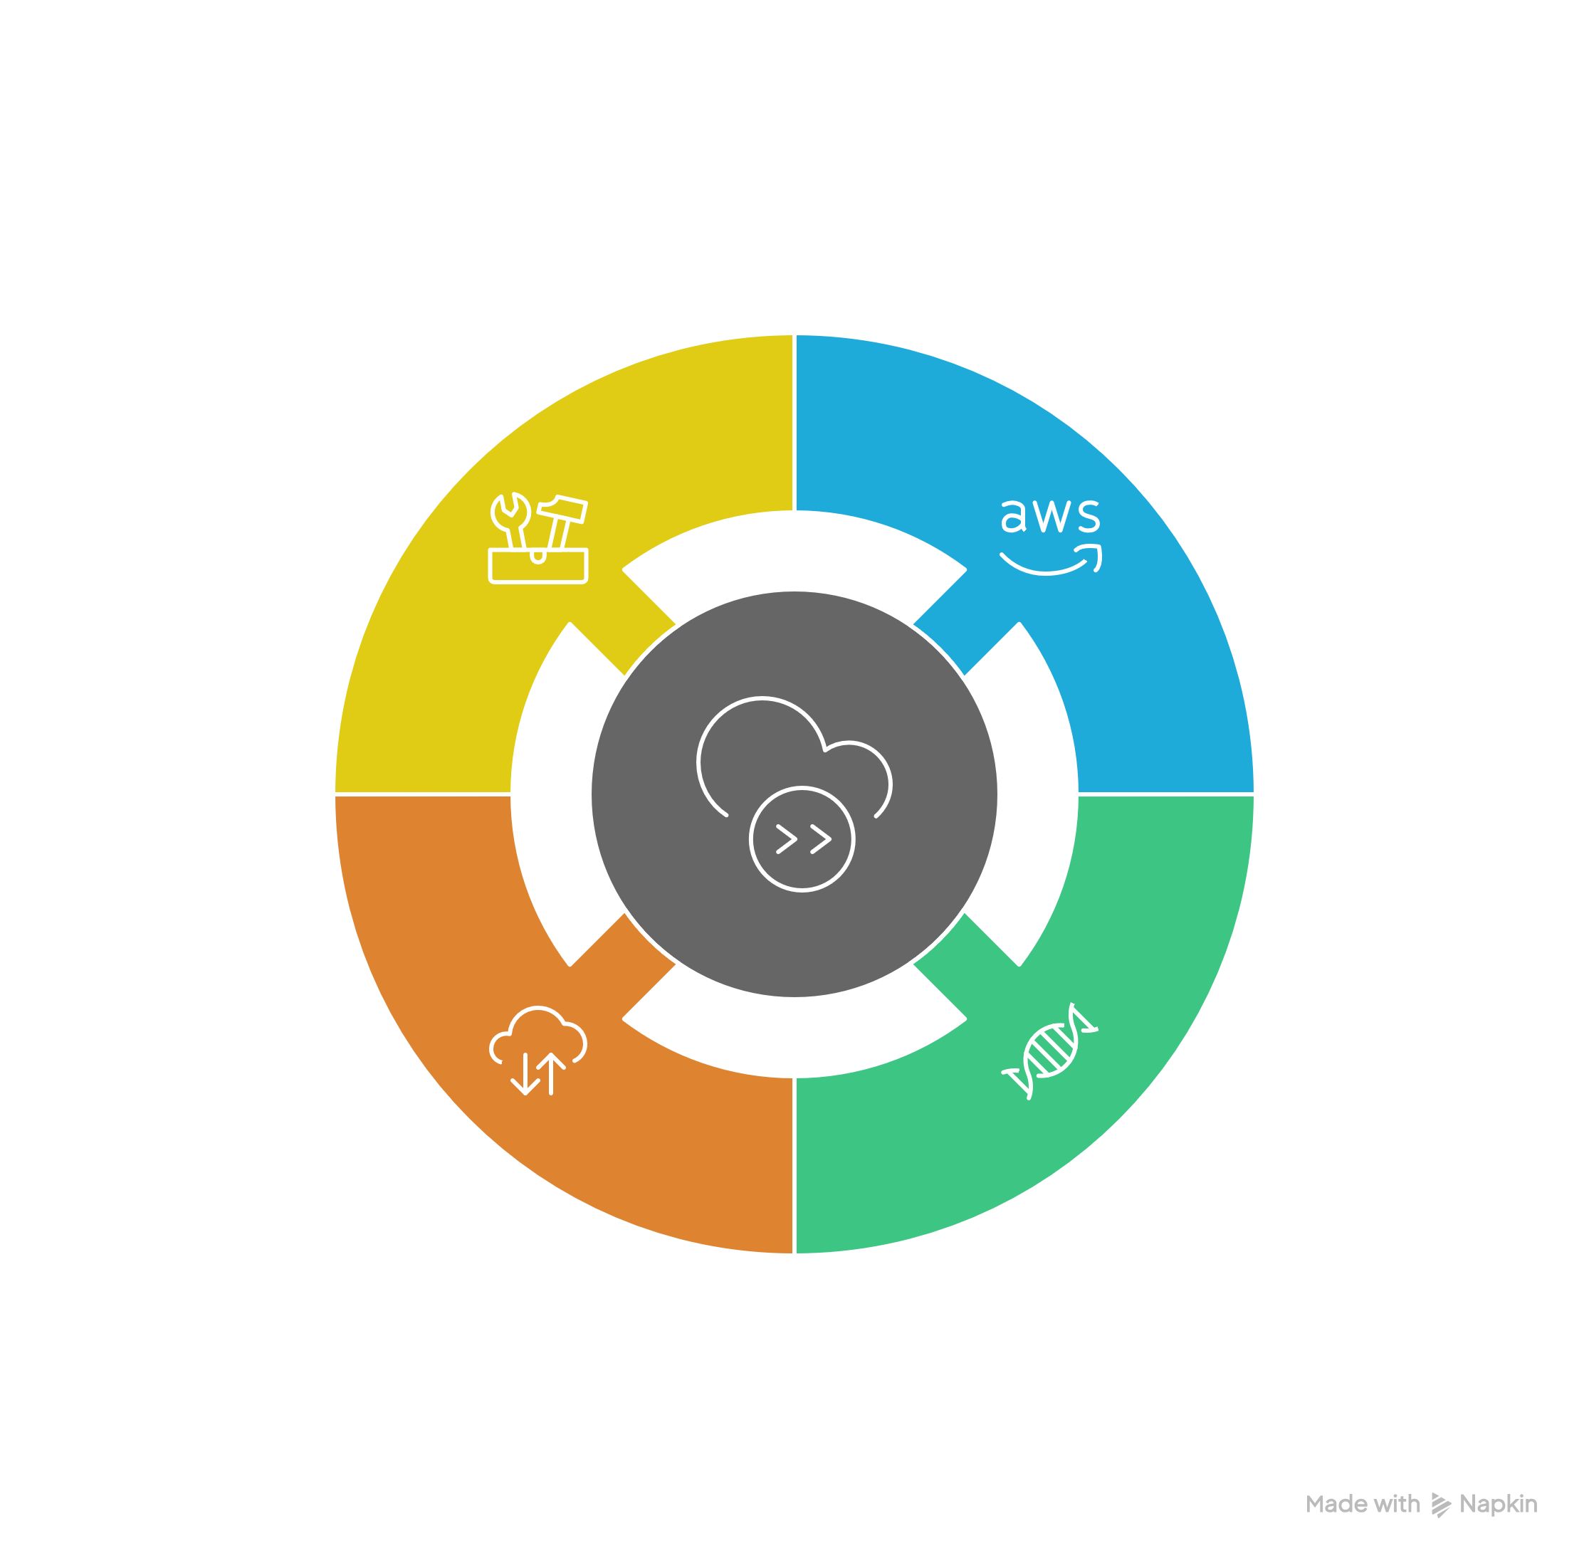
TABLE OF CONTENTS

Slide 3
01
What is AWS

Slide 4
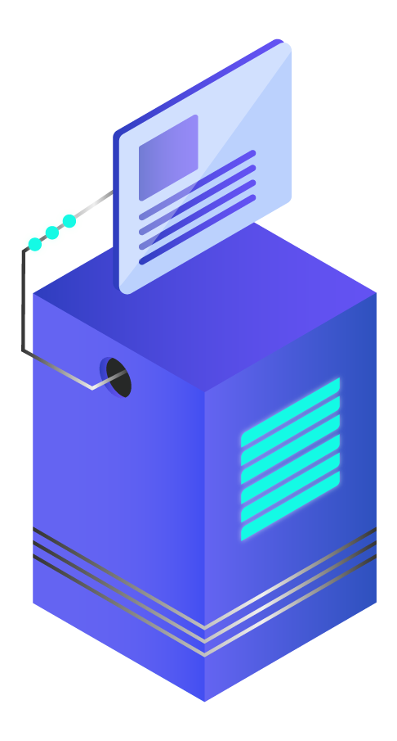
Question
What is the cloud computing?

Slide 5

—AWS
Cloud computing is the on-demand delivery of IT resources over the Internet with pay-as-you-go pricing. Instead of buying, owning, and maintaining physical data centers and servers, you can access technology services, such as computing power, storage, and databases, on an as-needed basis from a cloud provider like Amazon Web Services.
Notes:
https://aws.amazon.com/what-is-cloud-computing/
AWS is not the only option
GCP
AZURE
Alibaba CLOUD

Slide 6
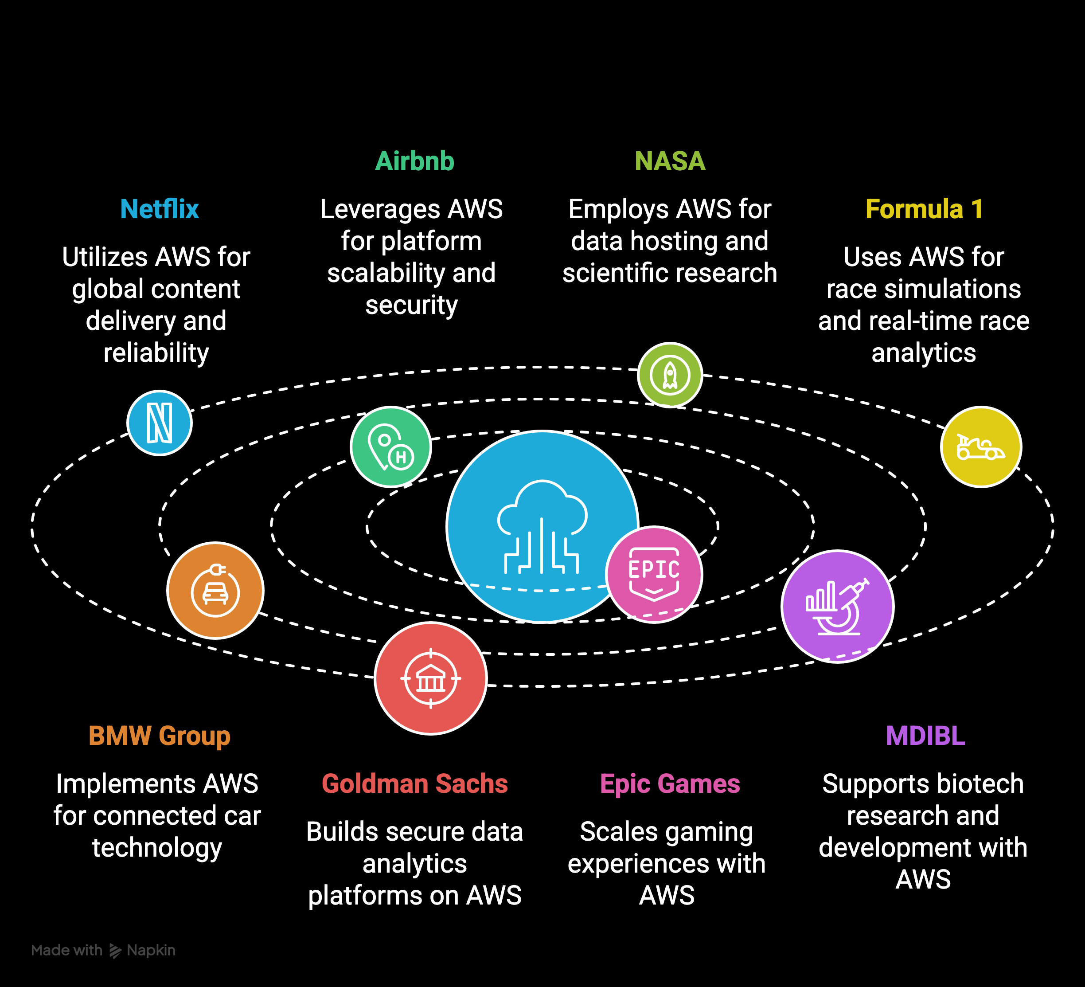
Applications

Slide 7
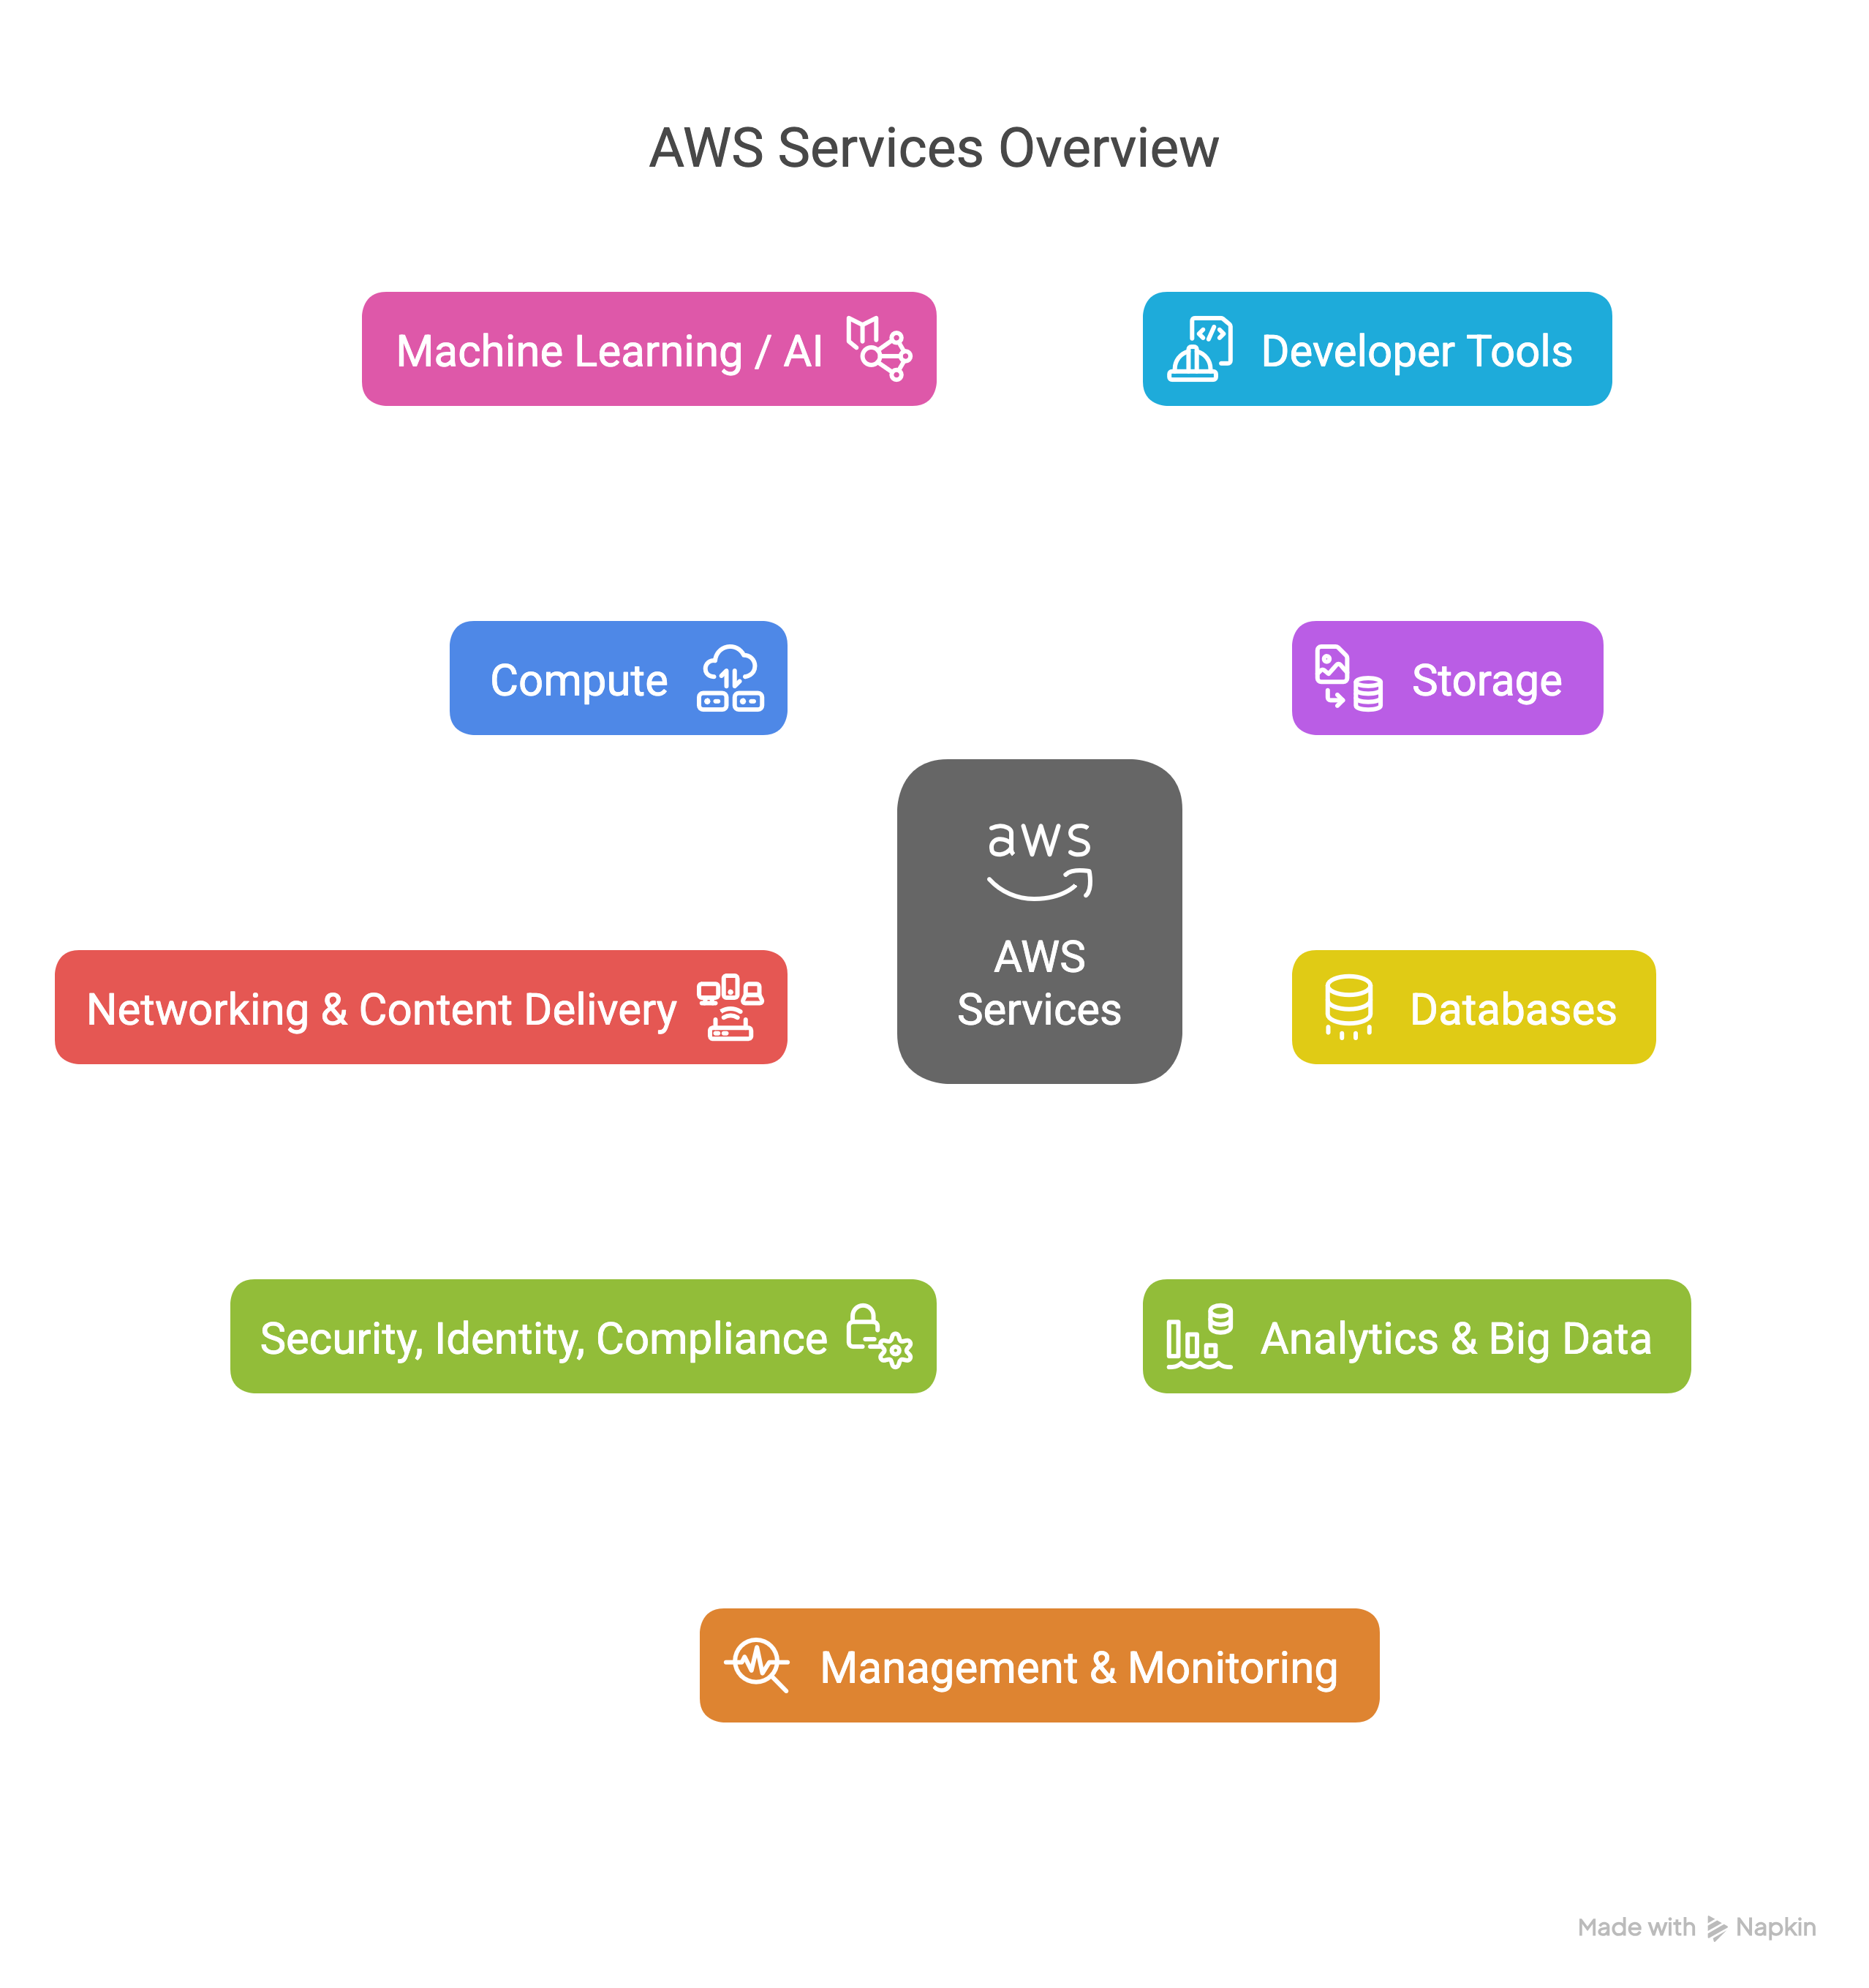
AWS
Distinct Services
+240
Extensive…
Only use a subset
Support from AWS
Massively scalable -- use as you like

Slide 8
02
Bioinformatics Stack
Notes:
What is a STACK???
In software engineering, a stack refers to a collection of technologies used together to build and run applications.

Slide 9
Services

Slide 10

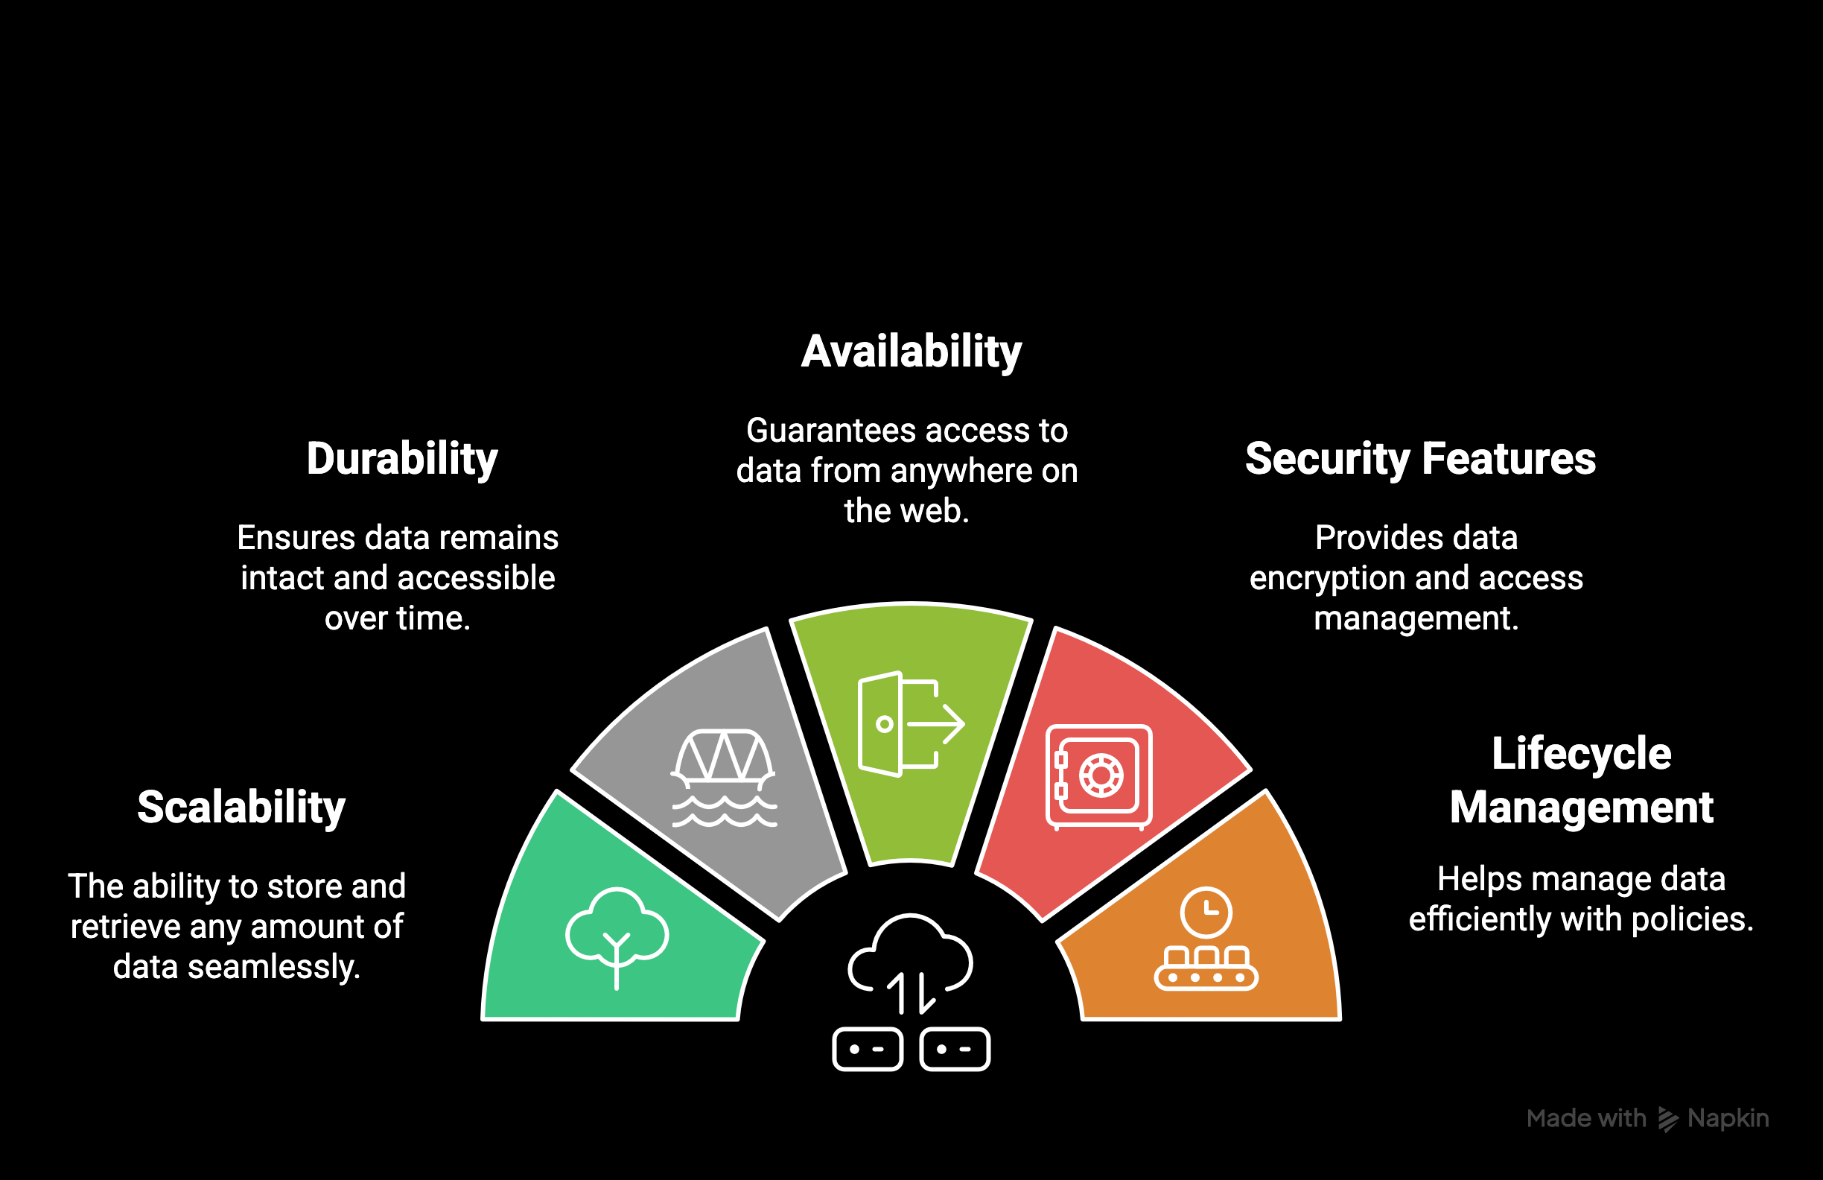

Storage – S3
Simple Storage Service

Slide 11
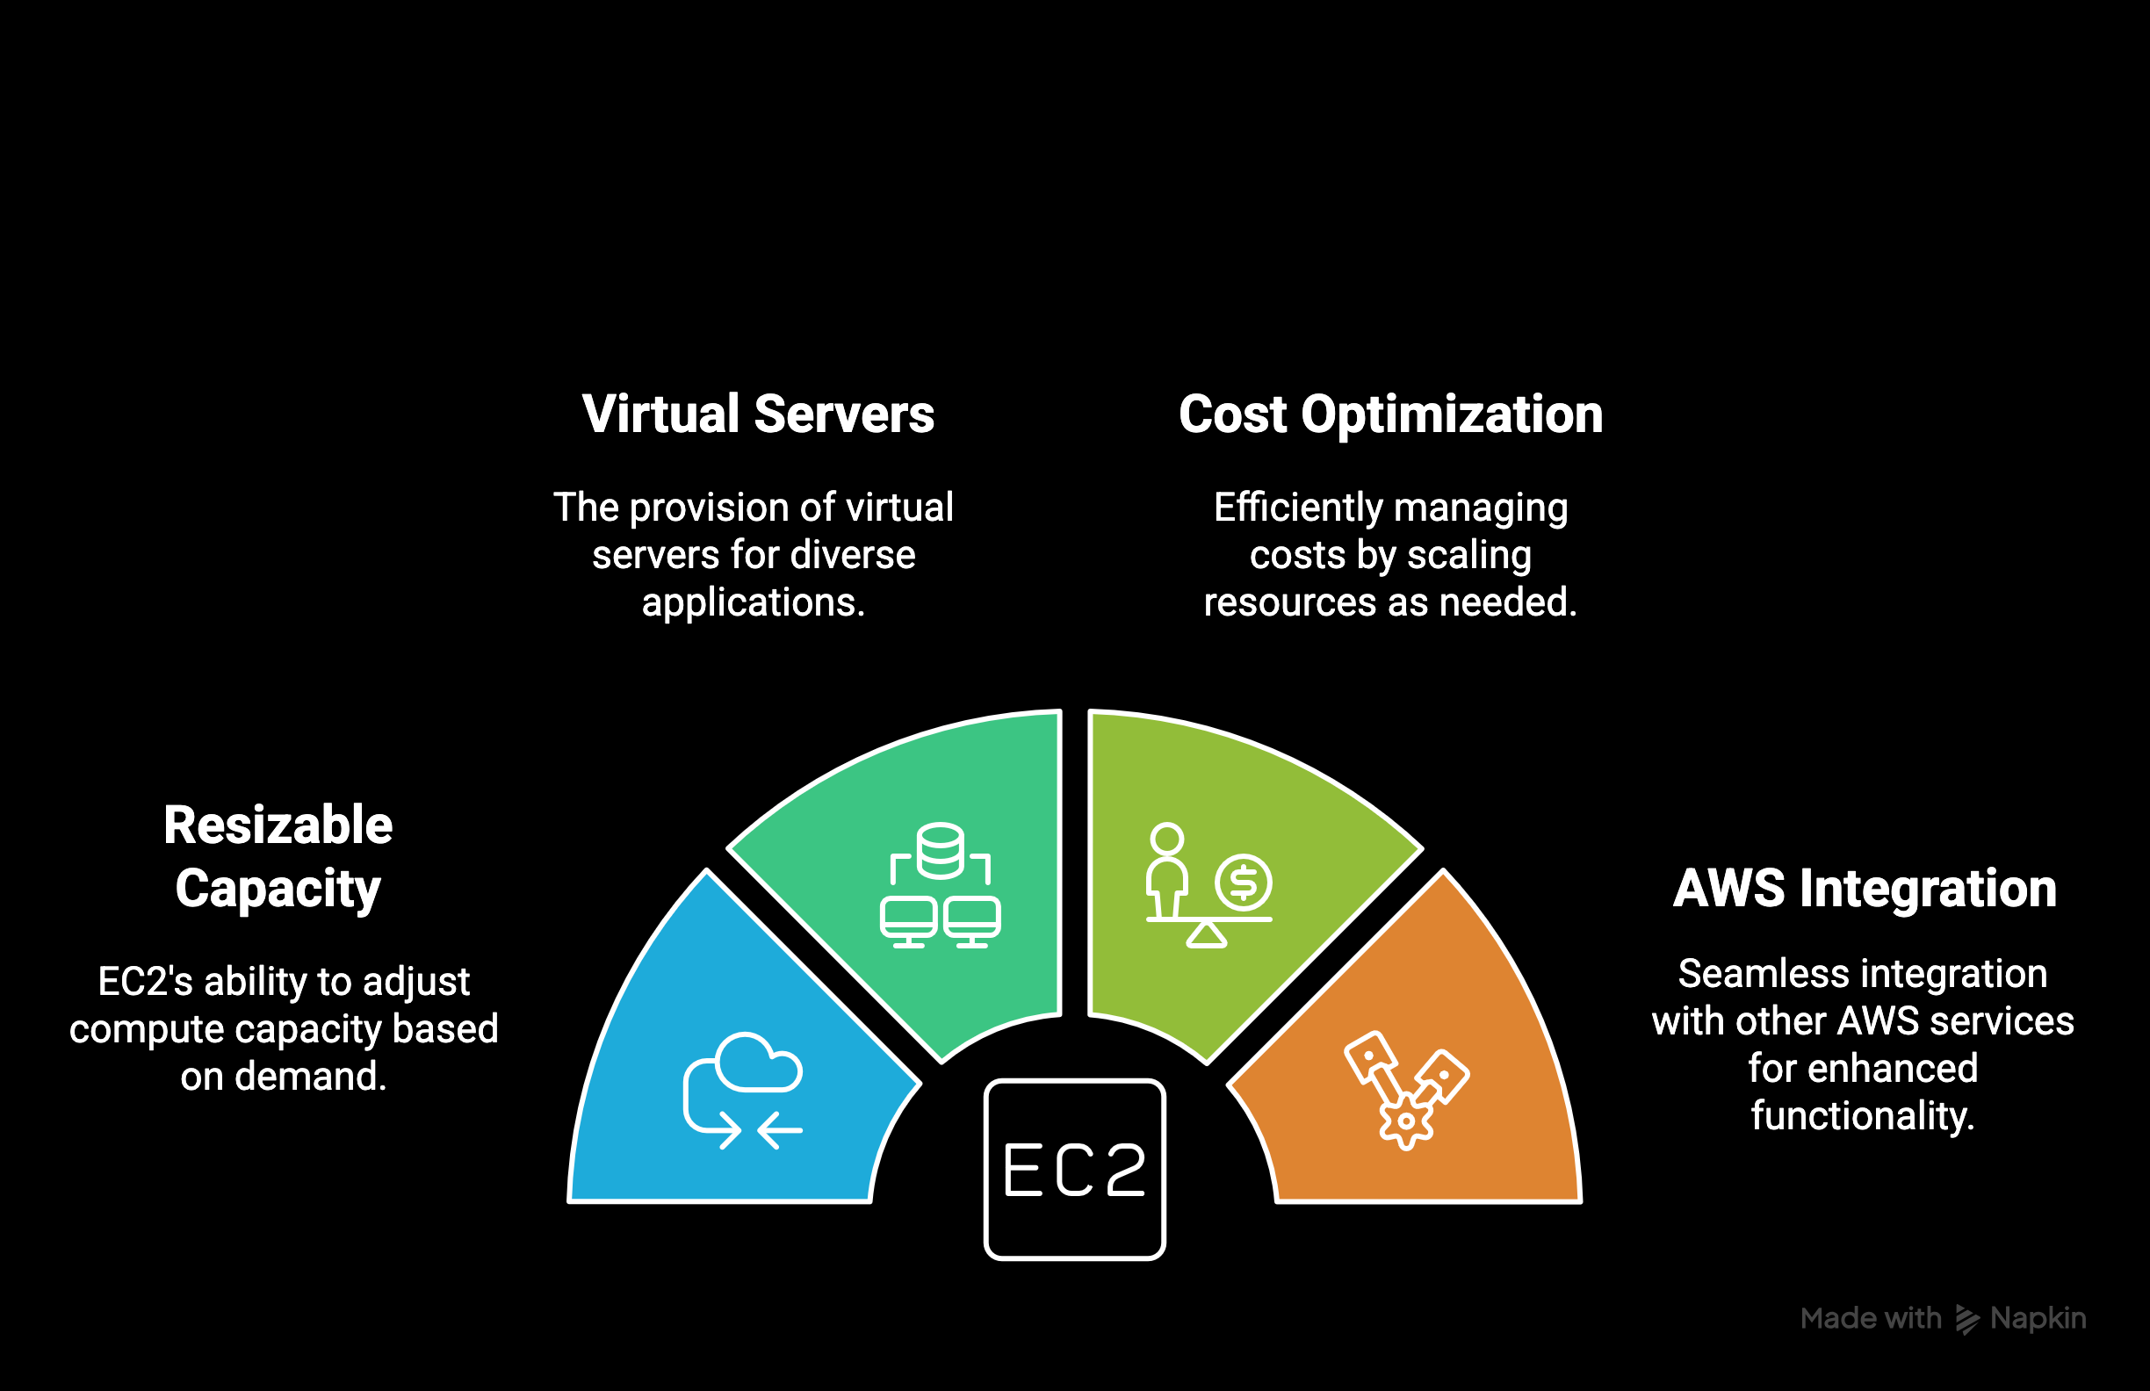

Compute – EC2
Elastic Compute Cloud

Slide 12
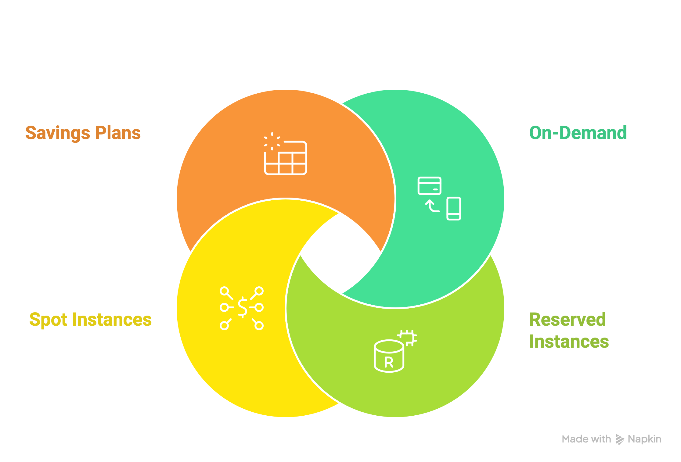
Compute – EC2
Elastic Compute Cloud

Slide 13

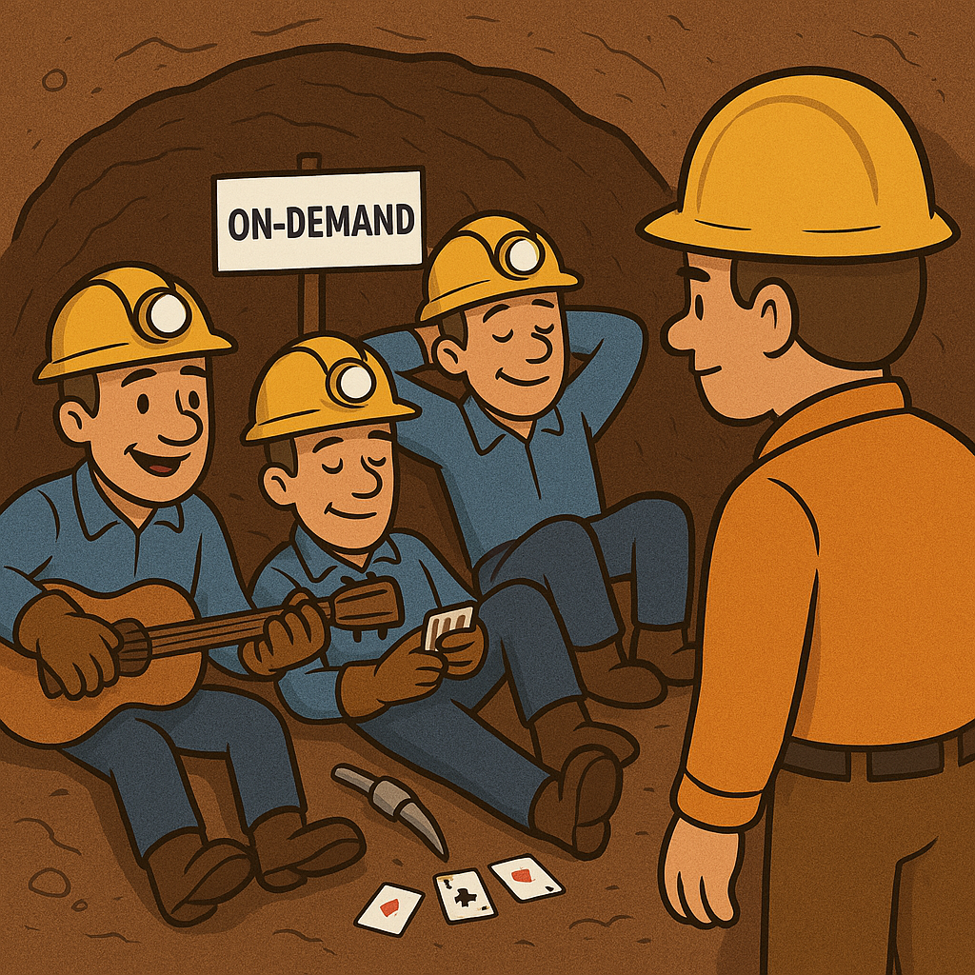
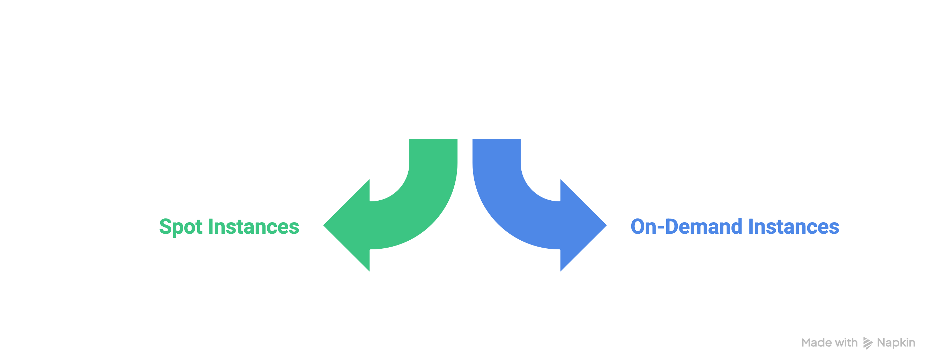
Compute – EC2
Elastic Compute Cloud
$0.30893
r5.4xlarge
$1.008
$0.8930
x1e.4xlarge
$3.336

Slide 14
03
Memverge

Slide 15
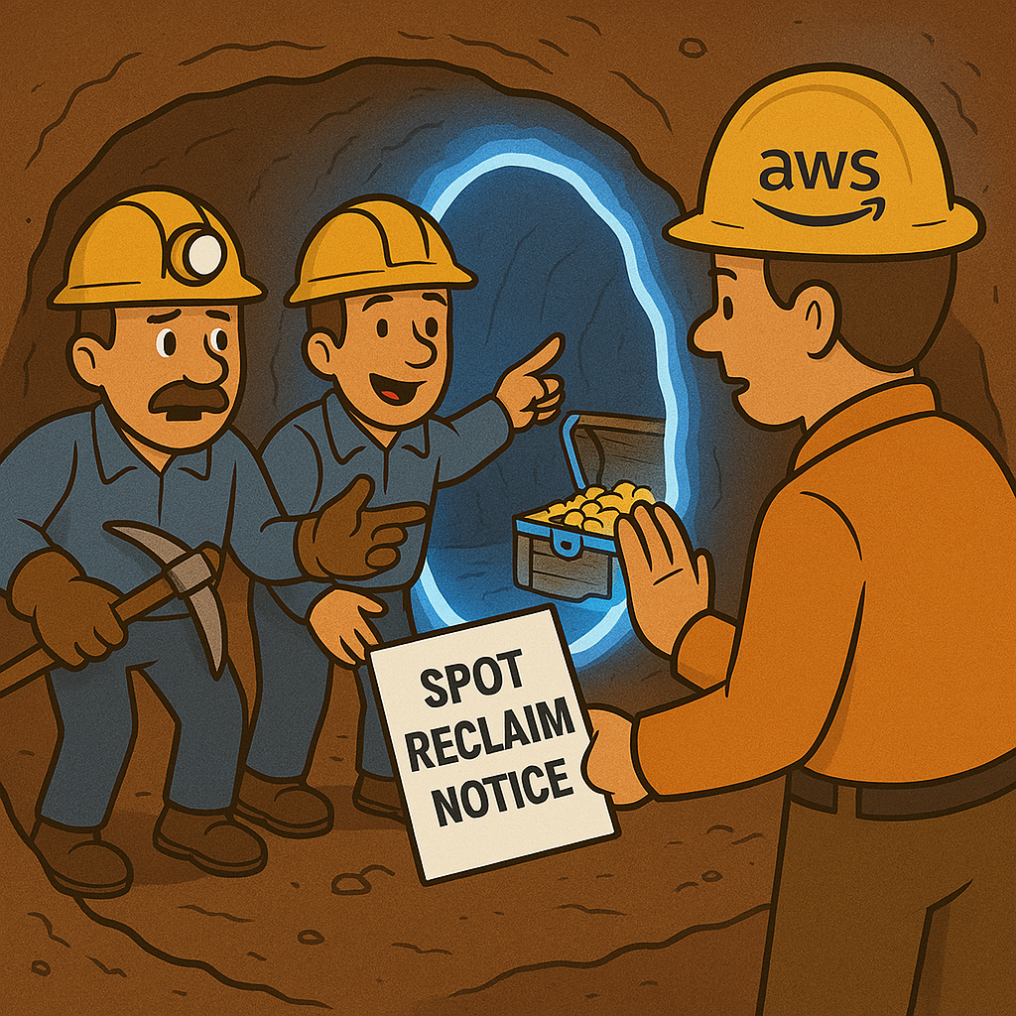
MEMVERGE SpotSurfer

Slide 16
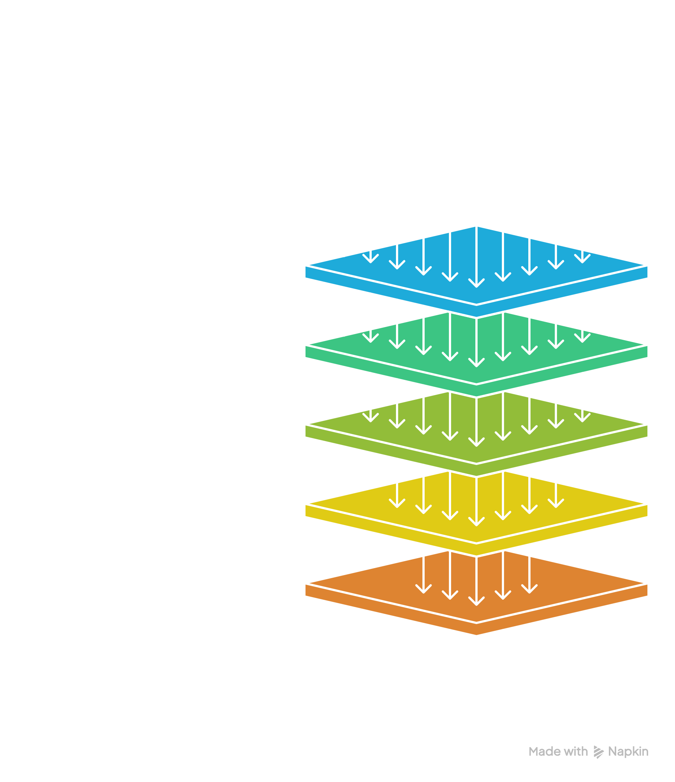

Memverge - SpotSurfer
Memory Machine Cloud
Notes:
FROM SPOT RECLAIM

Slide 17
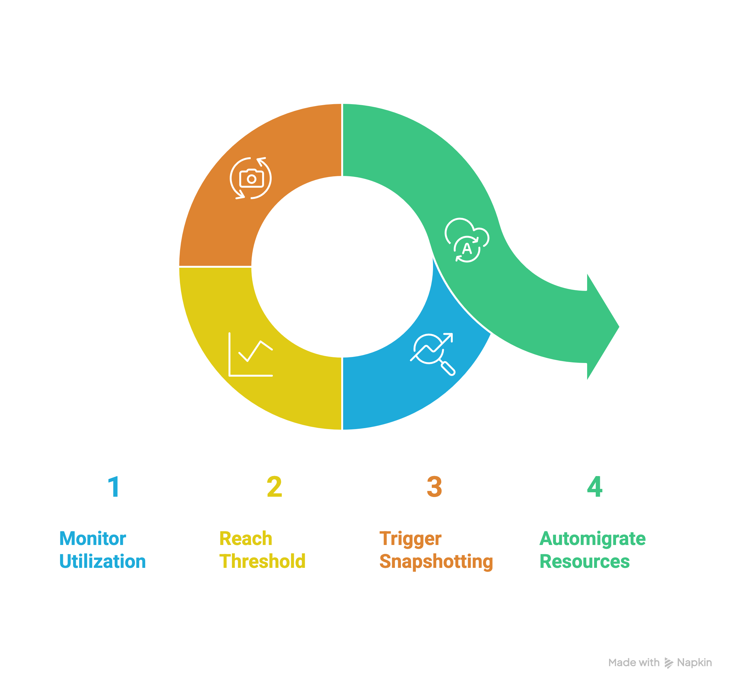
Memverge - WaveRider
Memory Machine Cloud
Notes:
OUT OF MEMORY
WHO KNOWS THE DIFFERENCE BETWEEN MEMORY AND STORAGE
💾
Computer Memory (RAM): Like a Work Desk
Memory (usually RAM) is like your desk when you’re working.
It’s where your computer temporarily holds things it’s actively using—open files, running apps, etc.
The bigger your desk (more RAM), the more stuff you can work on at once without slowing down.
But when you turn off your computer, everything on that “desk” disappears.
🧠 Layman’s analogy:
“Memory is like your brain’s short-term memory—it helps you focus on things you’re doing right now, but if you don’t write them down, they’re gone when you stop working.”
📦
Storage (Hard Drive or SSD): Like a Filing Cabinet
Storage is like your filing cabinet or bookshelf—where you keep things long-term.
You save your documents, photos, and programs here, even when the computer is off.
It’s slower than memory but permanent (until you delete it).
🧠 Layman’s analogy:
“Storage is like your brain’s long-term memory—it keeps stuff even after you sleep or shut down.”

Slide 18




Architecture
AWS EC2 Virtual Machines
MMC OpCenter
Orchestrates Jobs
AWS S3 Storage
Data & Reference
Head Node
(read only)
Executes Workflow
Work
Directory
Publish Directory
Worker Nodes

Slide 19
04
Other Use Cases

Slide 20

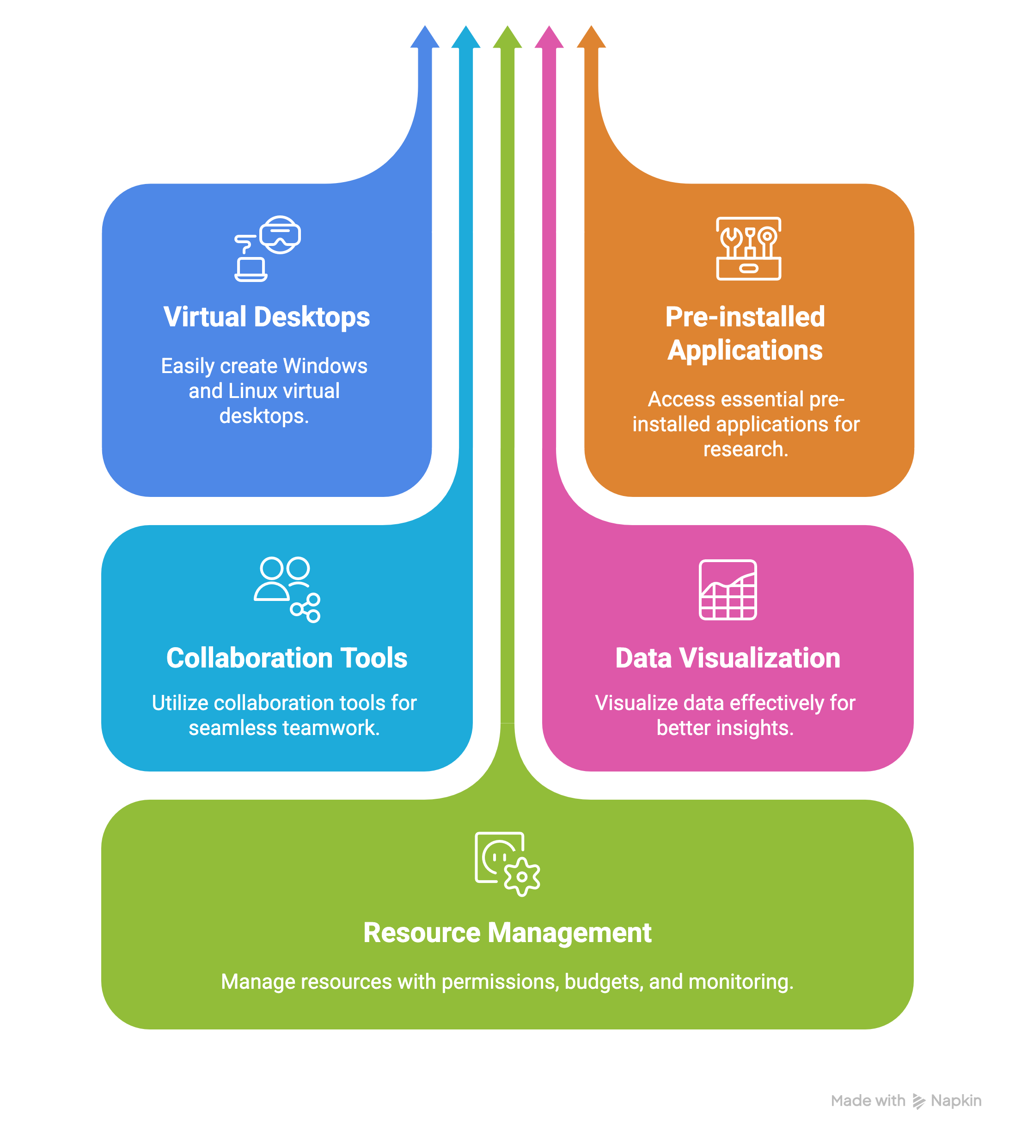
AWS - RES
Research Engineering Studio

Slide 21

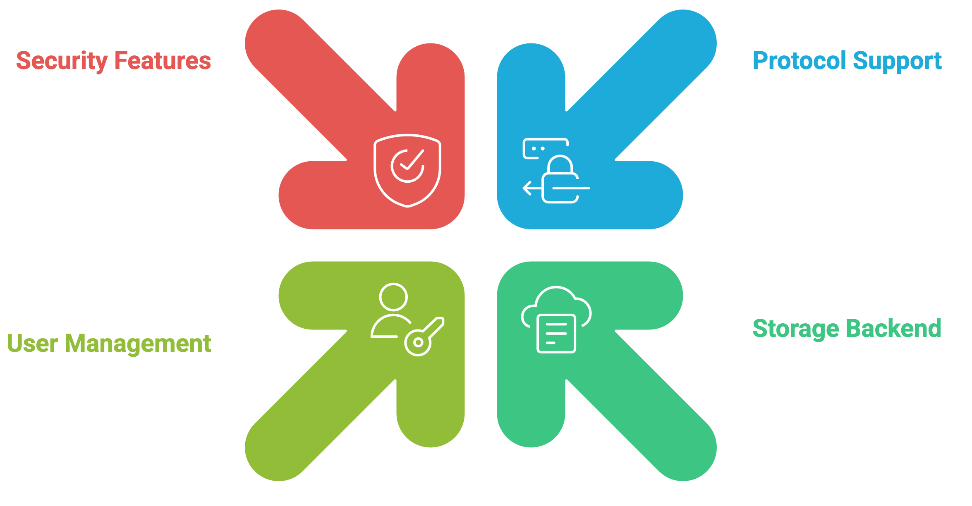
AWS - Transfer
Transfer Family

Slide 22

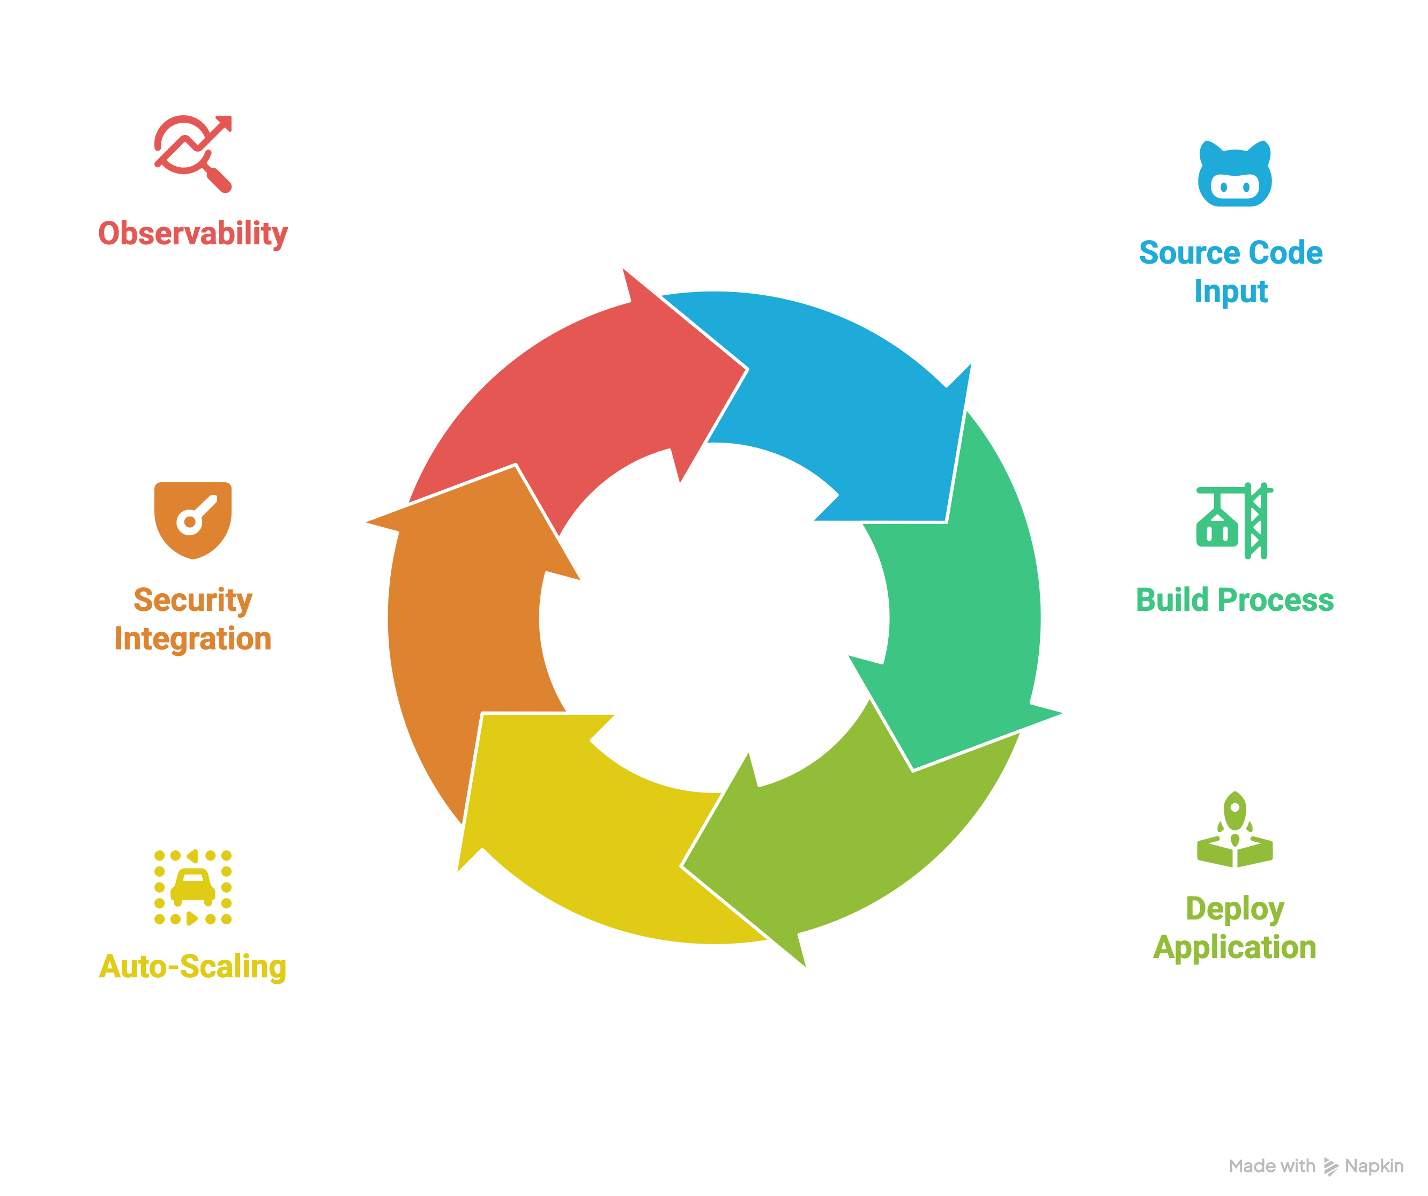
AWS - Apps
App Runner
Notes:
Lightsail, fargate

Slide 23
Questions

